Slide 1
Presentation Title
Date - Your Name

Slide 2
Headline
The Agenda of items we’ll cover
Numbered list item 1
Numbered list item 2
The last item, number 3

Slide 3
Bulleted (Unordered) List Template
This is a template for including an unordered list
Bulleted list
This is the second item in the list
And this is the third
Source: Wikipedia

Slide 4
Ordered List Template
This is a template for including an ordered list
Numbered list item 1
Numbered list item 2
Item 3
The last item, number 4

Slide 5
Code Block Example
This is an example of how to include a code block
This block of text is a descriptor for what’s happening in the code block below
# here is some code
total <- 0
for (i in 1:10){
message(i)
total <- total + i
}
message(total)

Slide 6
More Example Slides
There are more example slide templates after this
SEE THE REMAINING SLIDES FOR MORE EXAMPLES

Slide 7
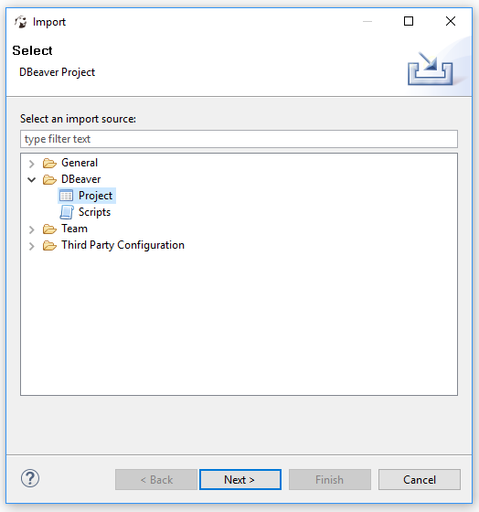
Getting Started
A template for having a screenshot at right
TEXT ON THE LEFT AND AN IMAGE AT RIGHT

Slide 8
Getting Started
A template of having two resources to cover in order
Resource #1
Do you have an internet connection?
Do you have credentials?
Resource #2
Installed?
Do you have project?
Can you connect to database?
Can you see scripts? Do they execute?

Slide 9
Why Databases?
A template for conveying quite a bit of text mixed with bullets
Relational data models:
Are very easy to extend
Improve and maintain data integrity
Allow for re-assembling data many different ways without reorganizing the underlying structure
“Normalization” is the extent to which the data replicated into multiple places within the database.
Highly Normalized = Little Redundancy = More Joins
Denormalized = More Redundancy = Less Joins

Slide 10
SQL Statement Basics
A template for having a code block and text surrounding to explain
The basic outline of a SQL query is SELECT, FROM, WHERE
SQL is declarative, just tell the database what you want! But…
it can get messy so format your queries to be easy to read.
SELECT productid , name , listprice FROM production.product WHERE productnumber = 'LO-C100' ;

Slide 11
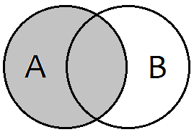
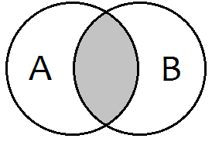
SQL Join Types
A template for comparing two different code blocks
A “JOIN” connects data from 2 or more tables (similar to VLOOKUP)
LEFT JOIN
SELECT COUNT(*) -- 504 records
FROM production.product p
LEFT JOIN production.productcategory as pc
ON p.productsubcategoryid = pc.productcategoryid
;
INNER JOIN
SELECT COUNT(*) -- 105 records
FROM production.product p
INNER JOIN production.productcategory as pc
ON p.productsubcategoryid = pc.productcategoryid
;

Slide 12
Resources
A template for listing out a bunch of resource links
W3Schools - http://www.w3schools.com/sql/
Hacker Rank - https://www.hackerrank.com/domains/sql/select
SQL Zoo - http://sqlzoo.net/wiki/AdventureWorks
Codecademy - https://www.codecademy.com/learn/learn-sql
Other Data Science Club Members
Experienced Professionals are all around you!

Slide 13
Questions?
A template for questions and contact info of presenters
In Person - Ask Now!
Via Email -
Club Inbox - DataScienceClub@darden.virginia.edu
YOUR NAME – YOUR EMAIL HERE
For Example,
Steve Mortimer - MortimerS19@darden.virginia.edu

